Slide 1
Project 1: Building a Portfolio
This presentation is about building a portfolio. It covers the process of asset selection, return calculation, portfolio optimization, risk tolerance, CAPM formula, efficient frontier, CML equation, tangency point, individual security market lines, and performance measures.
Submitted by
Jamisetti Venkata Sai Kalyan Aashish - M22AI561 Krishna Kumari Ravuri - M22AI567 Chaitrashree C - M22AI539 Bharathi Sontem - M22AI536 Rakesh Reddy Kadapala - M22AI608

Slide 2

Introduction
To design an investment strategy balancing risk and return in a volatile market, we collected historical data of stocks and implemented it in Python.
We are followed two key approaches:
Markowitz's mean-variance optimization: This helps construct the efficient frontier, representing the best portfolios for different risk tolerance levels. The project identifies two optimal portfolios on this frontier and calculates their weights.
Capital Asset Pricing Model (CAPM): This estimates expected returns for assets and plots them as the Capital Market Line (CML). The project finds the tangency point where CML and efficient frontier meet, representing the portfolio with the highest Sharpe ratio (return per unit of risk).
By analyzing individual Security Market Lines (SMLs) for specific assets and calculating risk-adjusted measures like the Sharpe Ratio, the project emphasizes the importance of diversification in mitigating risk and achieving optimal portfolio performance.

Slide 3
Description of selected stocks
Company Name | Industry | Brief Description
Indian Railway Finance Corporation Limited (IRFC) | Financial Services | Public sector undertaking financing Indian Railways' infrastructure projects.
Gujarat Pipavav Port Limited (GPIL) | Logistics & Infrastructure | Private port operator in Gujarat, India.
Hindustan Unilever Limited (HINDUNILVR) | Consumer Goods | Leading FMCG company in India with a diverse product portfolio.
RBL Bank Limited (RBLBANK) | Banking & Finance | Private sector bank with a focus on retail and corporate banking.
Life Insurance Corporation of India (LICI) | Insurance | Largest life insurance company in India, offering a range of insurance products.

Slide 4
Description of selected stocks
Company Name | Industry | Brief Description
ITC Limited (ITC) | Consumer Goods | Diversified conglomerate with interests in FMCG, hotels, and paper & packaging.
Wipro Limited | Information Technology | Global IT services company offering consulting, digital transformation, and cloud solutions.
Tata Elxsi Limited | Information Technology | Design and technology services company focusing on automotive, aerospace, and communications.
Indian Oil Corporation Limited (IOC) | Oil & Gas | State-owned oil refining and marketing company in India.
Reliance Industries Limited (RELIANCE) | Conglomerate | Major player in oil & gas, retail, telecom, and digital services.

Slide 5
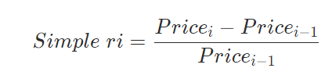

Simple & log returns for each stock:
Simple Returns: Simple returns are calculated as the difference between the closing price of one day and the closing price of the previous day, divided by the closing price of the previous day.
Log Returns: Log returns are calculated as the natural logarithm of the ratio between the closing price of one day and the closing price of the previous day

Slide 6
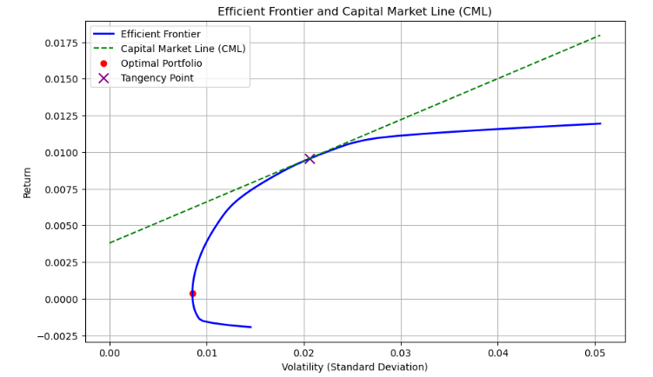
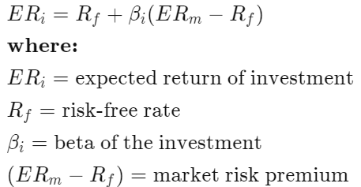
Capital Asset Pricing Model (CAPM) formula to calculate the expected return for each stocks.
It is a financial model which gives the linear relation between systematic risk and the expected returns for assets.
CAPM estimates the expected return of an asset based on its beta, representing its sensitivity to market movements
The expected returns obtained through CAPM provide valuable insights into the potential performance of the assets within the portfolio
By analyzing the expected returns derived from CAPM, investors can assess the attractiveness of individual assets and allocate their investments strategically to optimize risk-adjusted returns.

Slide 7
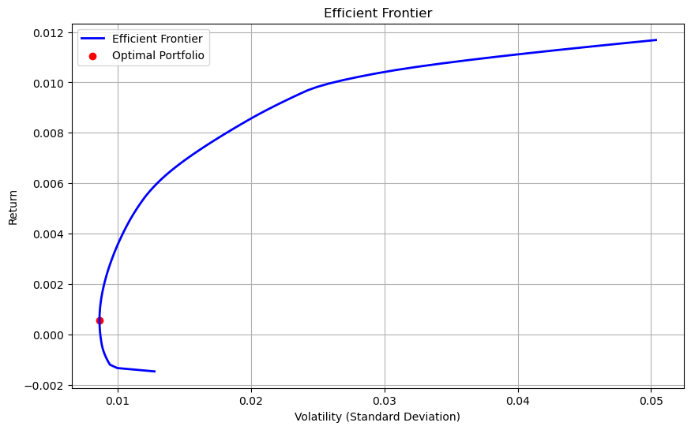
Markowitz efficient frontier
Efficient Frontier : The efficient frontier is the set of optimal portfolios that offer the highest expected return for a defined level of risk or the lowest risk for a given level of expected return.

Slide 8
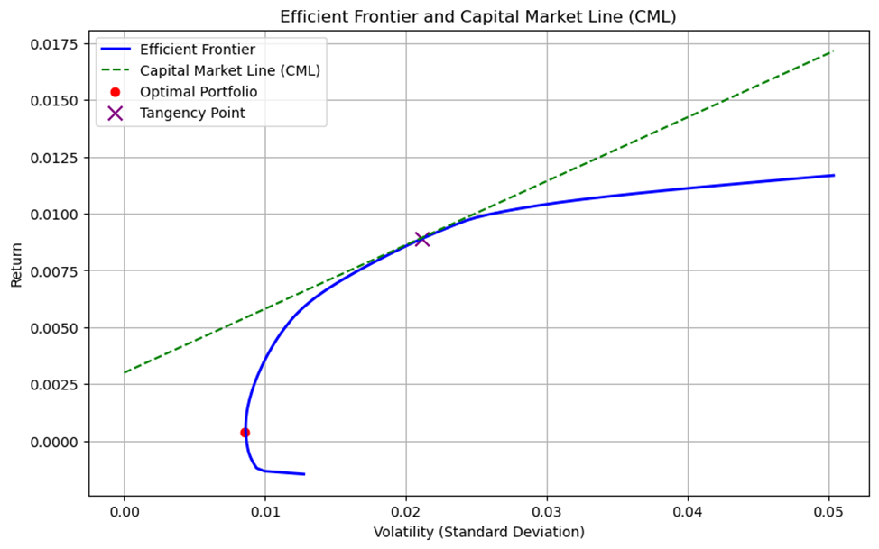
Constructing CML:
The Capital Market Line is a graphical representation of all the portfolios that optimally combine risk and return
The point of tangency is the most efficient portfolio.

Slide 9
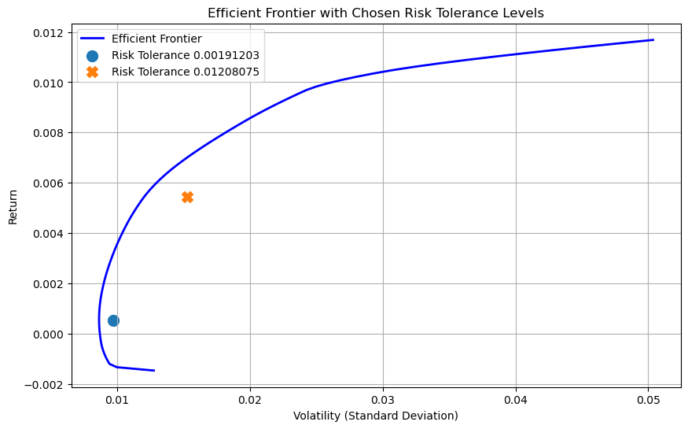
Efficient Frontier for Differing Risk Tolerance Levels: Optimal Portfolio Weights
Risk tolerance levels at the points chosen:
 | Point 1 (0.00191203) | Point 2 (0.01208075)
IRFC.NS | 0.0218 | 0.1669
IOC.NS | 0.0255 | 0.1463
LICI.NS | 0.027 | 0.14
WIPRO.NS | 0.0455 | 0.1031
RELIANCE.NS | 0.0537 | 0.0955
GPIL.NS | 0.0618 | 0.0899
RBLBANK.NS | 0.0848 | 0.079
HINDUNILVR.NS | 0.1546 | 0.0629
TATAELXSI.NS | 0.2084 | 0.0588
ITC.NS | 0.3169 | 0.0576

Slide 10
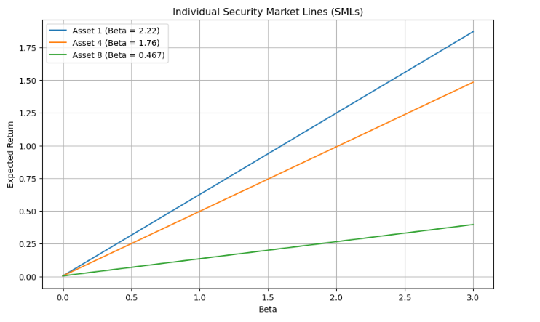
Individual Security Market Lines
SML
The Security Market Line gives the relationship between the expected return and the systematic risk (beta) of individual securities or portfolios.
Each SML illustrates how the expected return of an asset varies with changes in its beta, assuming a linear relationship based on CAPM. As beta increases, the expected return also increases, reflecting higher systematic risk and thus higher expected compensation for investors.

Slide 11
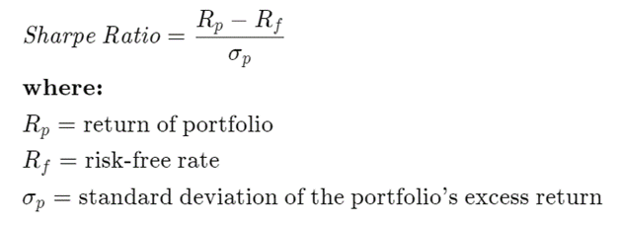
Performance Measures
Portfolio | Sharpe Ratio
Portfolio 1 | -0.3948
Portfolio 2 | -0.4583
Portfolio 3 | -0.5133
Portfolio 4 | -0.5532
Portfolio 5 | -0.5601
Portfolio 6 | -0.5531
Portfolio 7 | -0.5449
Portfolio 8 | -0.5355
Portfolio 9 | -0.5248
Portfolio 10 | -0.513
Portfolio 11 | -0.5001
Portfolio 12 | -0.4862
Portfolio 13 | -0.4718
Portfolio 14 | -0.4568
Portfolio 15 | -0.4414
Sharpe Ratio:
The Sharpe ratio compares the return of an investment with its risk. It's a mathematical expression of the insight that excess returns over a period of time may signify more volatility and risk, rather than investing skill.

Slide 12
Conclusion:
Portfolio 74 | 0.2681
Portfolio 75 | 0.2704
Portfolio 76 | 0.2725
Portfolio 77 | 0.2744
Portfolio 78 | 0.2761
Portfolio 79 | 0.2773
Portfolio 80 | 0.2782
Portfolio 81 | 0.2787
Portfolio 82 | 0.279
Portfolio 83 | 0.279
Portfolio 84 | 0.2788
Portfolio 85 | 0.2784
Portfolio 86 | 0.2779
Based on these Sharpe Ratios, investors looking for the best risk-adjusted returns should think about Portfolio 82, which offers the ideal ratio of return to risk. Additionally, portfolios 42 through 82 provide favorable and increasing risk-adjusted returns, which could make them appealing choices. Portfolios 1 through 39 perform poorly when adjusted for risk and might not be as appealing as they could be from an investment perspective. The efficiency of risk-adjusted returns starts to slightly decrease after Portfolio 83, indicating that portfolios beyond this point should carefully weigh risk against return.

Slide 13
Thank you for your time🙂

